Slide 1


Opening a Japanese Restaurant in New York, USA

Slide 2
Business Problem
The aim of this project is to analyse and choose the best locations in New York City to open a new Japanese restaurant.
Using the methodology of data science and various tools, this project aims to provide a solution to the problem: 'Where in New York City should the investor open a Japanese restaurant?’.
The best locations are defined as the places within New York City that will ensure a highly successful Japanese restaurant, in terms of consistent profit.

Slide 3
Data
Data Required:
New York City data containing the neighborhoods and boroughs.
Latitude and longitude coordinates of those neighborhoods. This is needed to get the venue data and plot the map.
Venue data, specifically data related to restaurants. This data will be used to perform additional analysis of the neighborhoods.
Data Sources:
Open-source dataset of New York: https://cocl.us/new_york_dataset
Geocoder package for latitude and longitude coordinates
Foursquare API for venue data

Slide 4
Methodology
Data will be taken from https://cocl.us/new_york_dataset and cleaned and processed into a dataframe.
Foursquare will be used to locate all venues and then filtered by Japanese restaurants. Data such as ratings, tips and likes by users will be added to the dataframe.
Data will be filtered by rankings.
Lastly, data will be graphed visually using matplotlib.

Slide 5
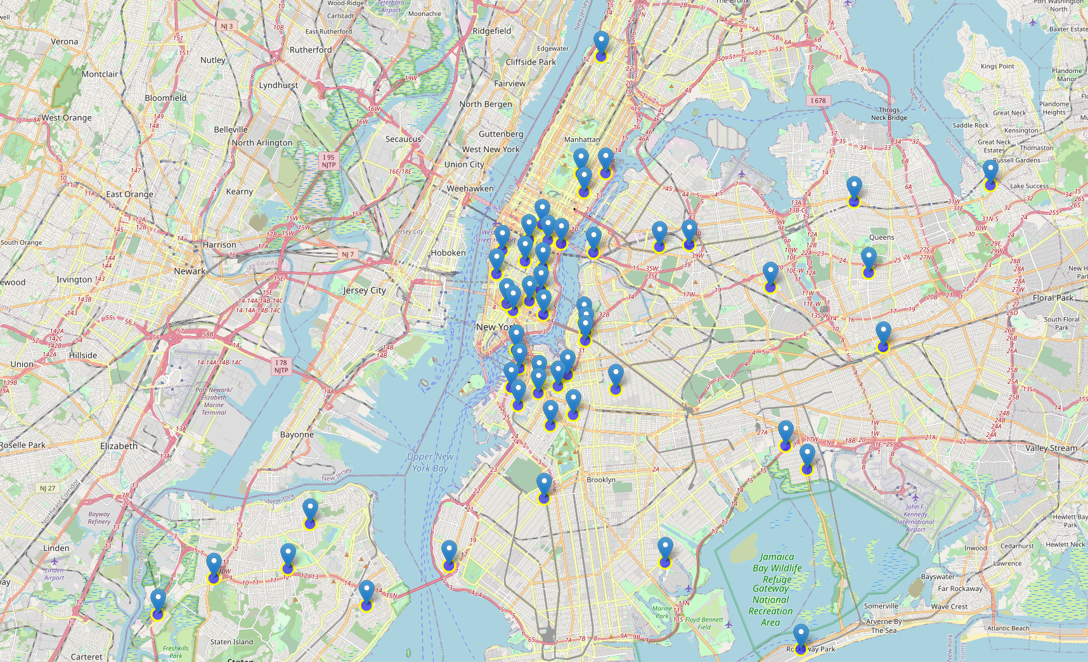
Results
Queens has the highest number of neighborhoods
Although Manhattan had the least number of neighborhoods, it has the highest number of Japanese restaurants.
Murray Hill, Midtown South and Flatrion in Manhattan all have the highest number of Japanese Restaurants with a total count of 4 each.
Surprisingly, all four neighborhoods have the same average rating of 8.3.

Slide 6
Discussion
Based on the analysis results, all four of the boroughs are equally as good for Japanese cuisine in New York City.
Brooklyn does have multiple neighborhoods with an average rating exceeding 8.0 and has less Japanese restaurants than Manhattan, making competition easier. In addition, real estate prices in Brooklyn are cheaper than the other boroughs.
Therefore, I would recommend considering opening a Japanese restaurant in Brooklyn in either Cobble Hill or in North side, as these two neighborhoods have the highest rating for Japanese restaurants.

Slide 7
Conclusions
The project applied different data science methods to produce an answer to the business question: 'Where in New York City should the investor open a Japanese restaurant?’
The findings of this project will assist the relevant investor better understand the advantages and disadvantages of different New York neighborhoods/boroughs in terms of opening a Japanese restaurant.

